Slide 1
A PRODUCT OF KRINARAI
FleatPro — How to Use FleatPro
Customer onboarding · September 2026

Slide 2
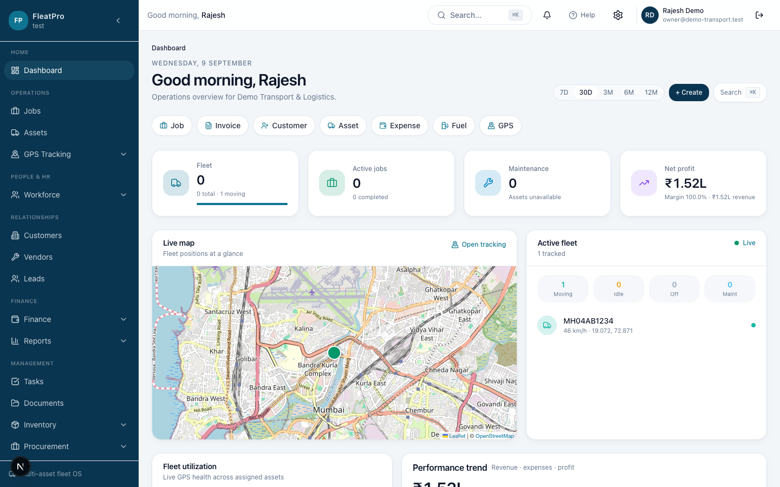
What FleatPro is
One workspace for operations, fleet, finance, and people
Built for transport and asset-heavy businesses
A product of KRINARAI

Slide 3
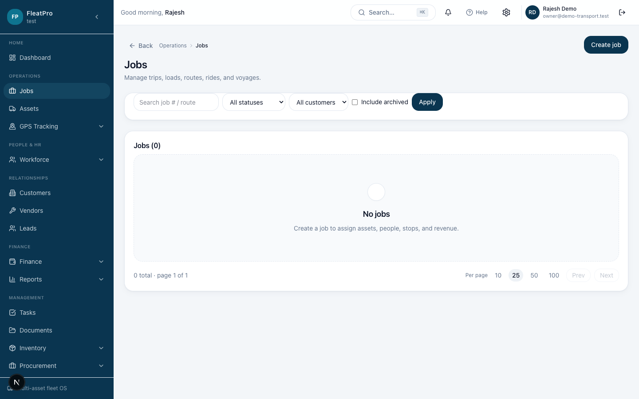
How operations work
Customers → Jobs → Fleet & people
Track progress and GPS movement
Invoice, collect payment, review reports

Slide 4
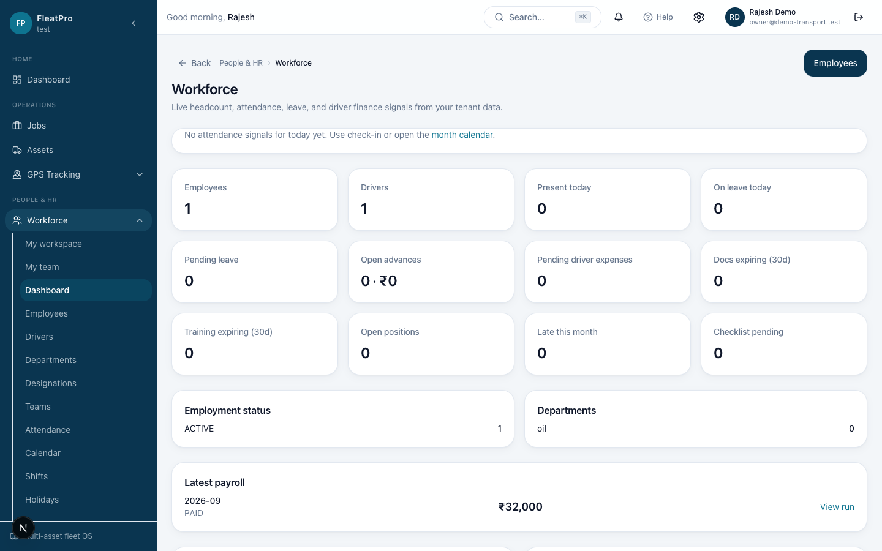
How people & HRMS work
Employees and drivers
Attendance and leave
Payroll runs and payslips
Documents with expiry awareness

Slide 5
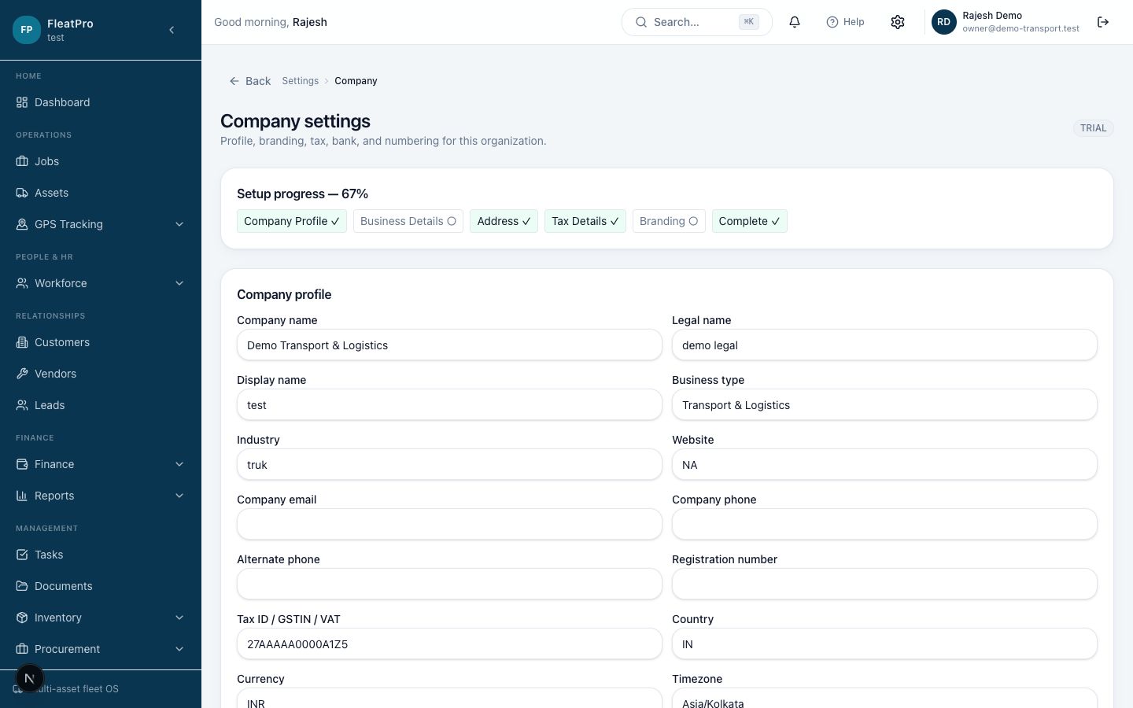
Getting Started (1–4)
Open Dashboard
Complete Company profile
Add Branches
Invite Team and set Roles

Slide 6
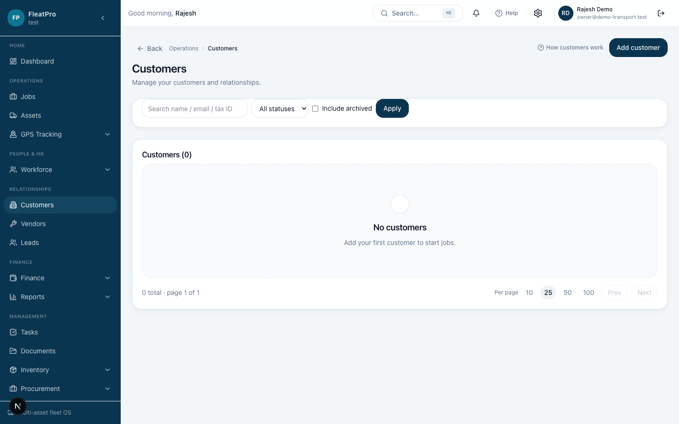
Getting Started (5–8)
Add Customers
Add Vendors
Register Fleet assets
Set up Drivers & people

Slide 7
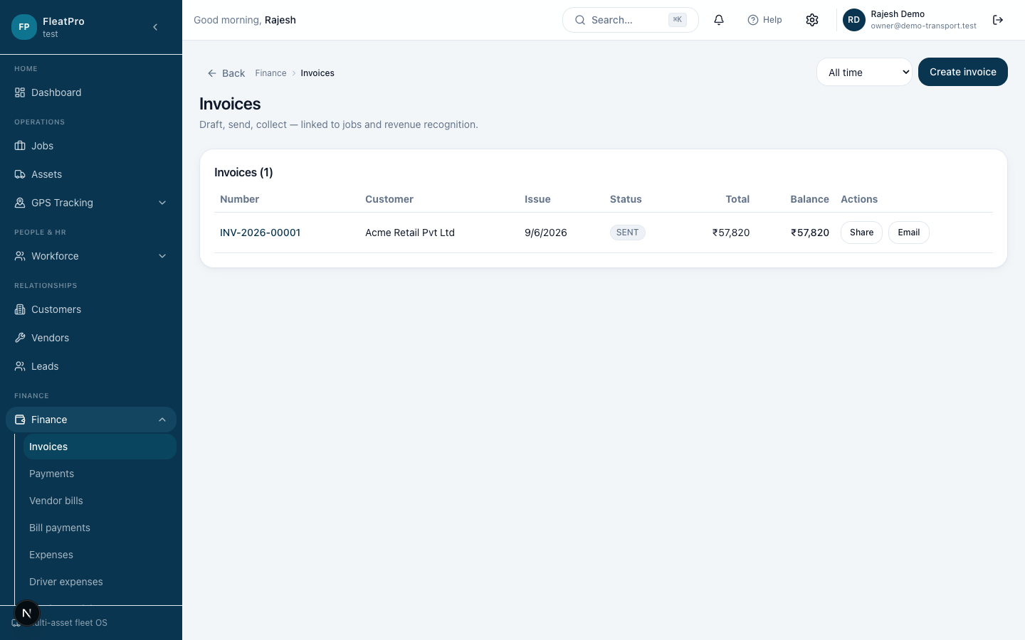
Getting Started (9–13)
Create Jobs
Connect GPS (optional)
Record Expenses
Invoice & collect Payments
Review Reports

Slide 8
Customers
Relationships → Customers
Link to jobs and invoices

Slide 9
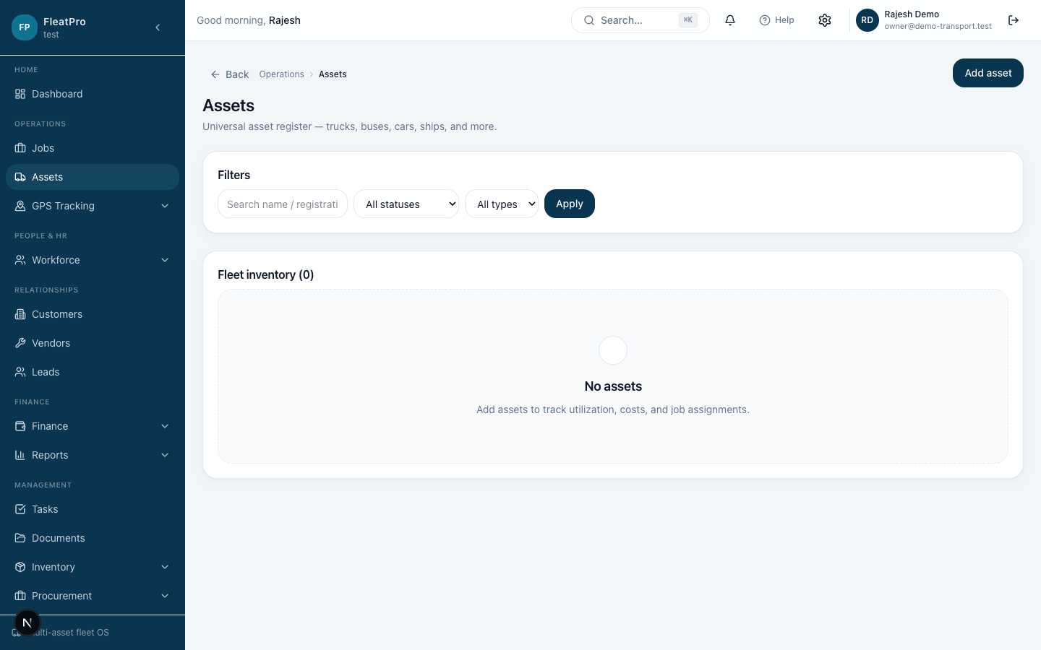
Fleet & assets
Operations → Assets
Assign to jobs and GPS devices

Slide 10
Jobs
Operations → Jobs
Assign people and assets
Update status as work progresses

Slide 11
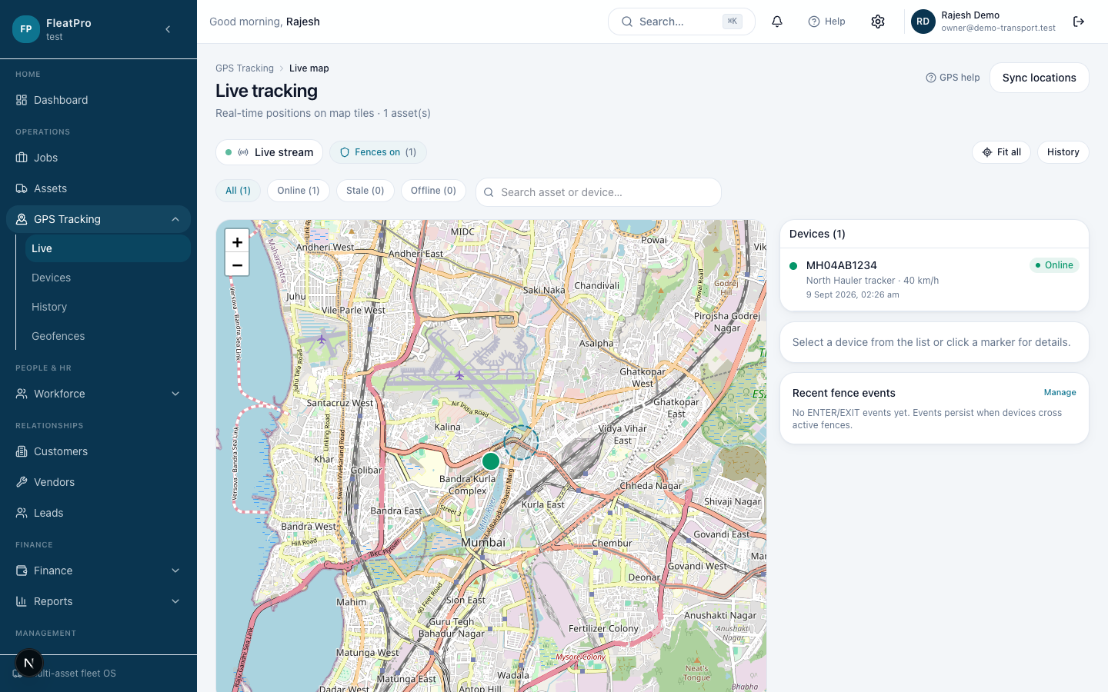
GPS tracking
Live map, devices, history, geofences
Trips appear after movement

Slide 12
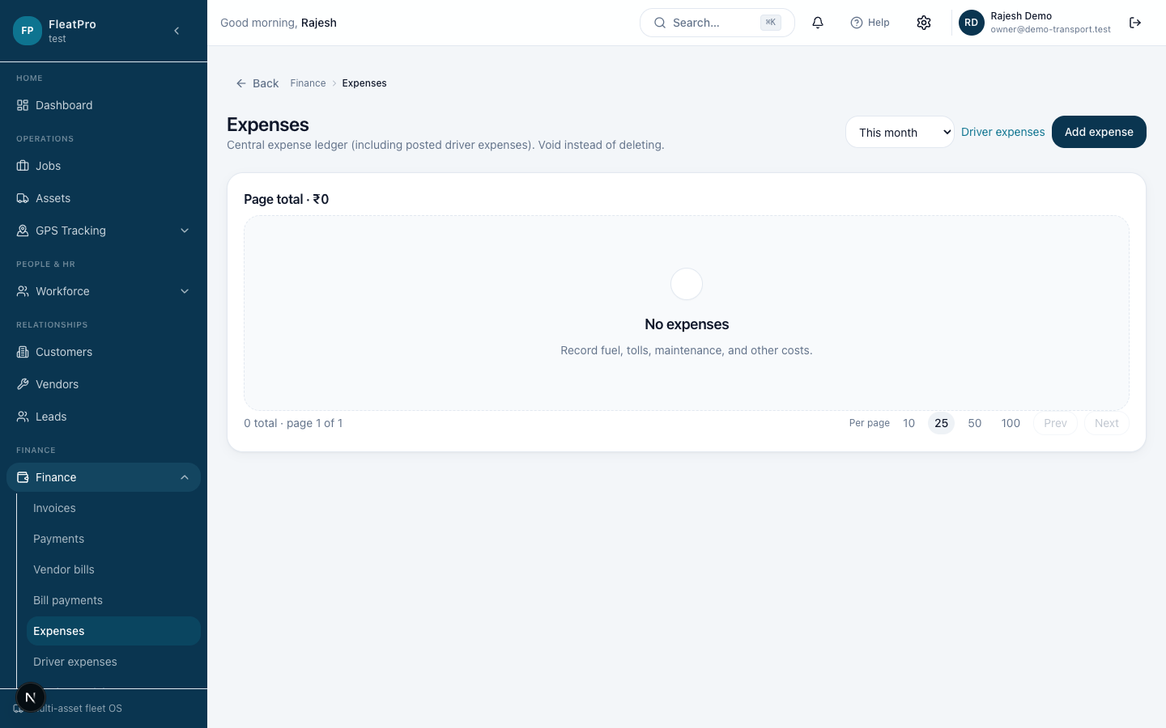
Expenses & driver claims
Finance → Expenses
Driver expenses for trip costs
Approve before ledger posting

Slide 13
Invoices & payments
Draft branded invoices
Share PDF or secure link
Record payments to clear balances

Slide 14
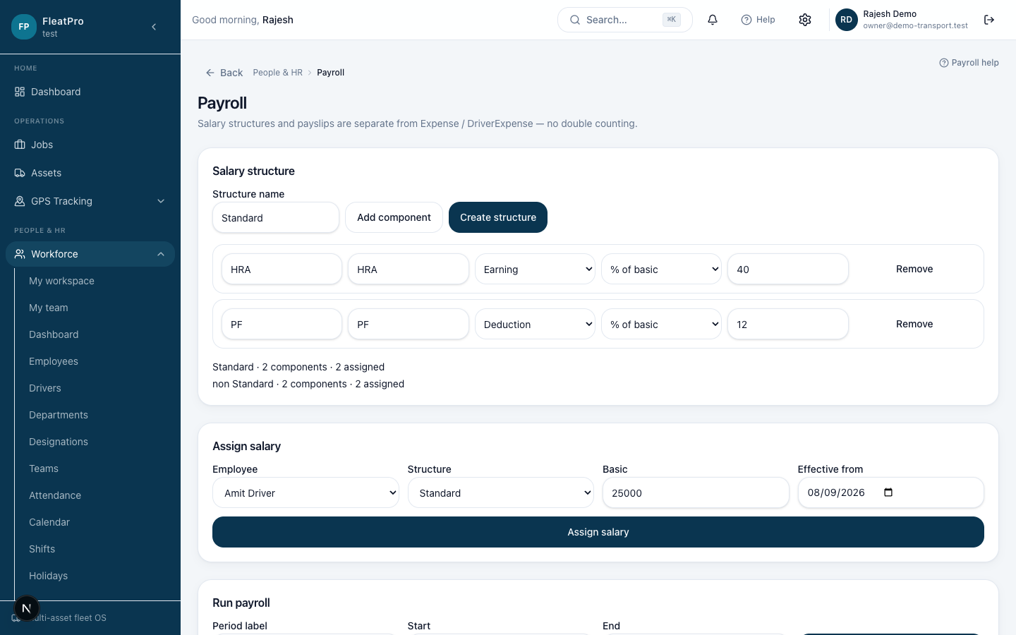
Payroll
People & HR → Payroll
Structures, runs, approve, pay
Payslips for employees

Slide 15
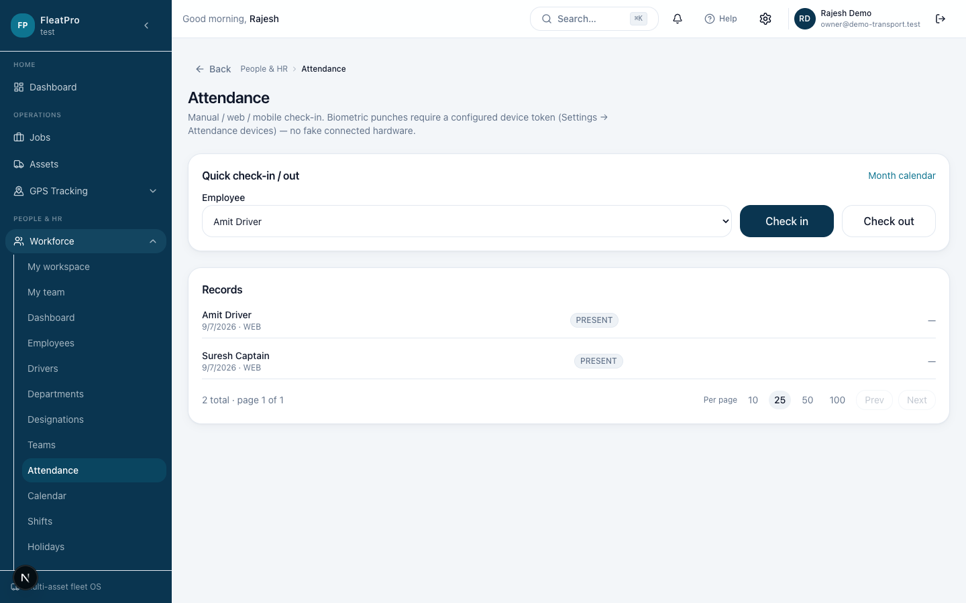
Attendance & leave
Attendance check-in and devices
Leave requests and manager inbox

Slide 16
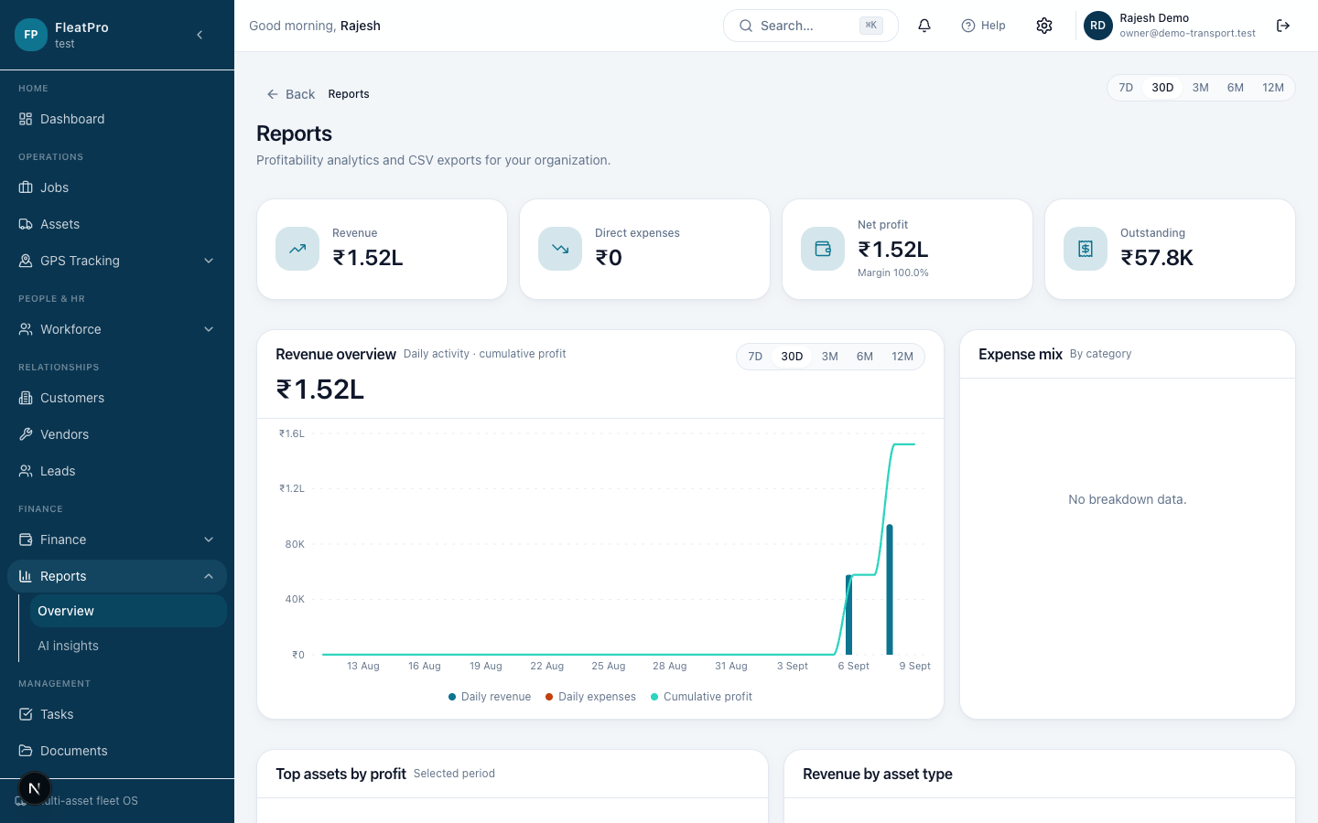
Reports & documents
Charts and CSV exports
Store licenses and contracts

Slide 17
Settings that matter
Company branding for invoices
Team, roles, email notifications
Billing for your company plan

Slide 18
Where to get help
In-app: header → Help
Public Help Center at /help
Download PDF and PPTX from /help/downloads

Slide 19
A PRODUCT OF KRINARAI
You’re ready
Open FleatPro Help Center and follow the checklist.

